Slide 2
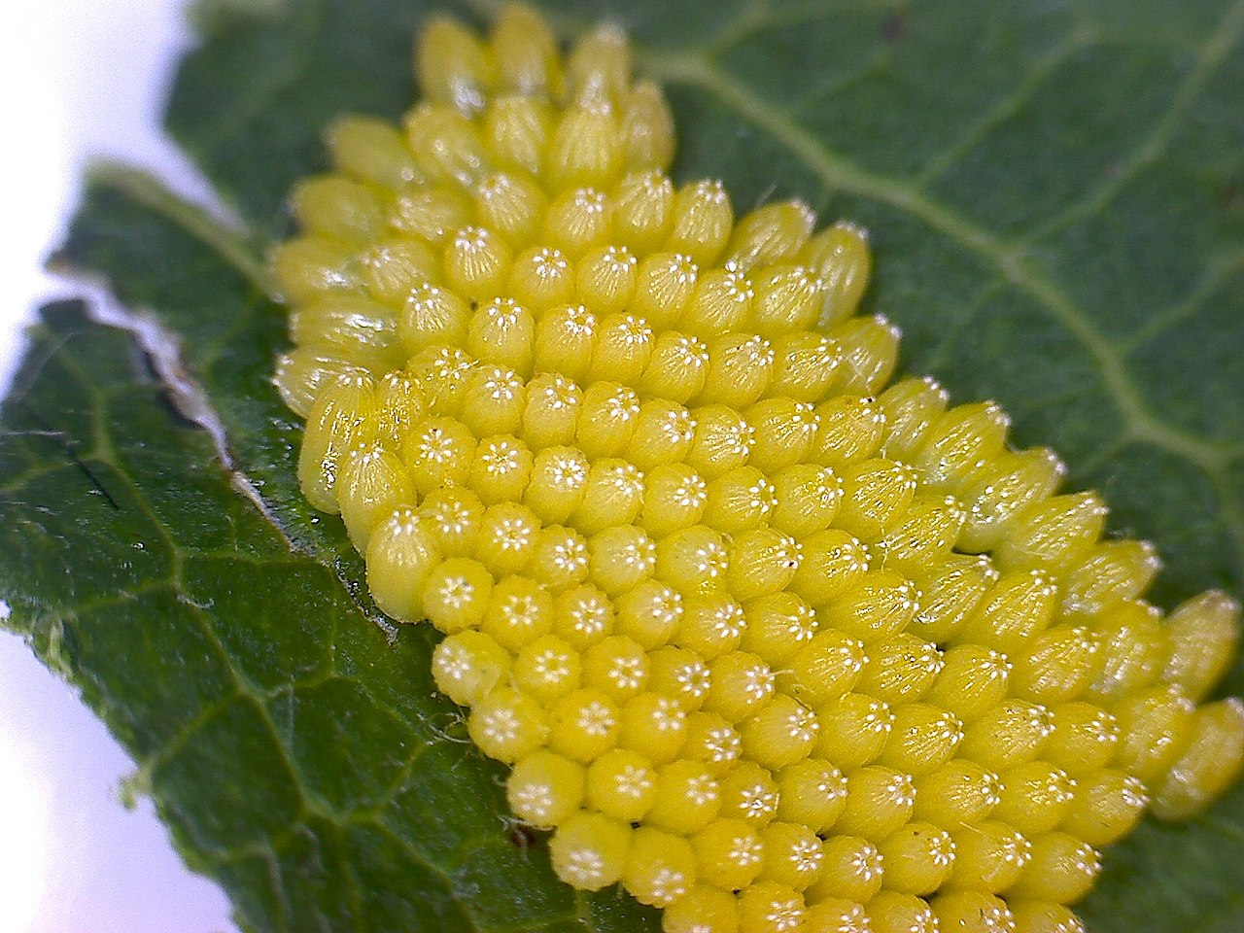
The Egg
The life cycle starts when a butterfly lays her eggs on a leaf or the stem
of a plant.
Photo courtesy of Волков Владислав Петрович (@flickr.com) - granted under creative commons licence – attribution

Slide 3
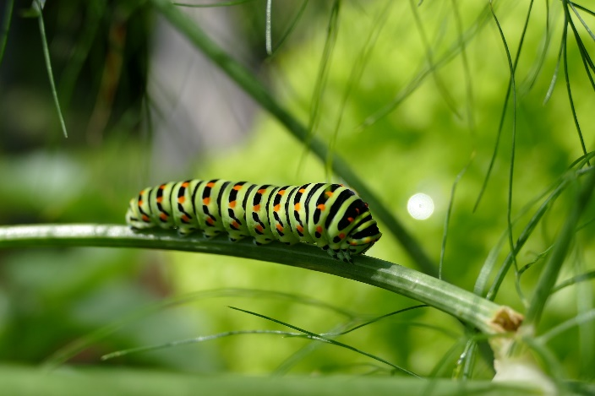
From Egg to Caterpillar
A tiny caterpillar eats its way out of the egg.
Caterpillars eat lots of leaves and grow very quickly.
As the caterpillar eats more and more, it gets bigger and bigger.
This means that the caterpillar needs to shed its skin because it
becomes too tight.
A caterpillar may shed its skin four or five times as it grows!

Slide 4
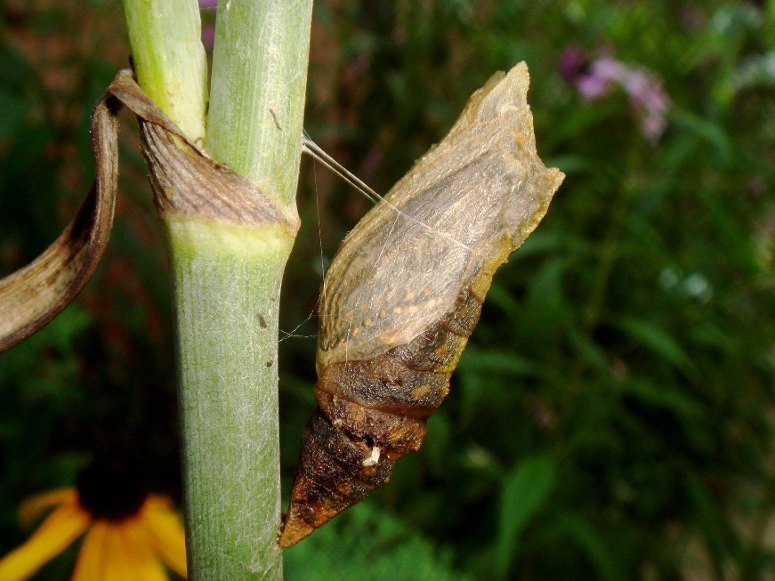
From Caterpillar to Chrysalis
When the caterpillar is fully grown, it changes itself into a chrysalis.
This is the stage that happens after it is a caterpillar, but before it becomes a butterfly.
Inside the chrysalis, the caterpillar changes into a butterfly.

Slide 5
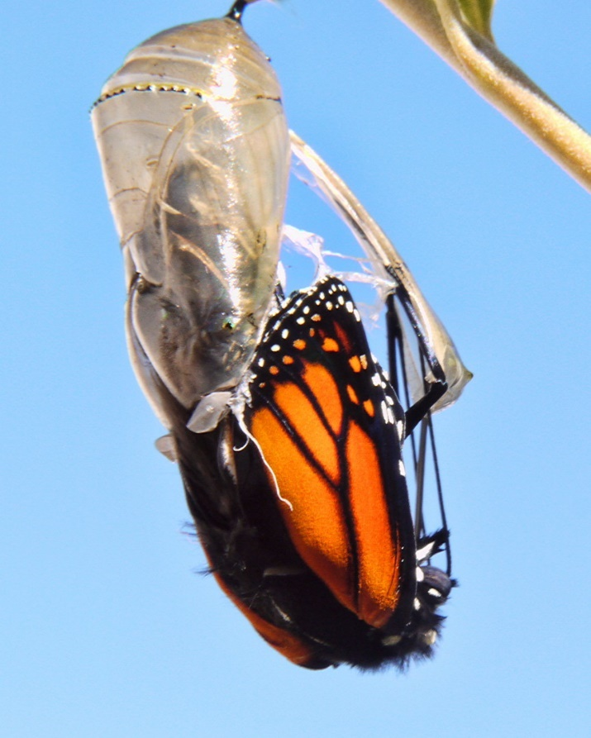
The Butterfly
When the butterfly is ready, the chrysalis splits open and the butterfly crawls out.
The butterfly cannot fly straight away because its wings are soft, wet and wrinkled.
The butterfly needs to wait until its wings are dry before it can fly.
Photo courtesy of SidPix (@flickr.com) - granted under creative commons licence – attribution

Slide 6
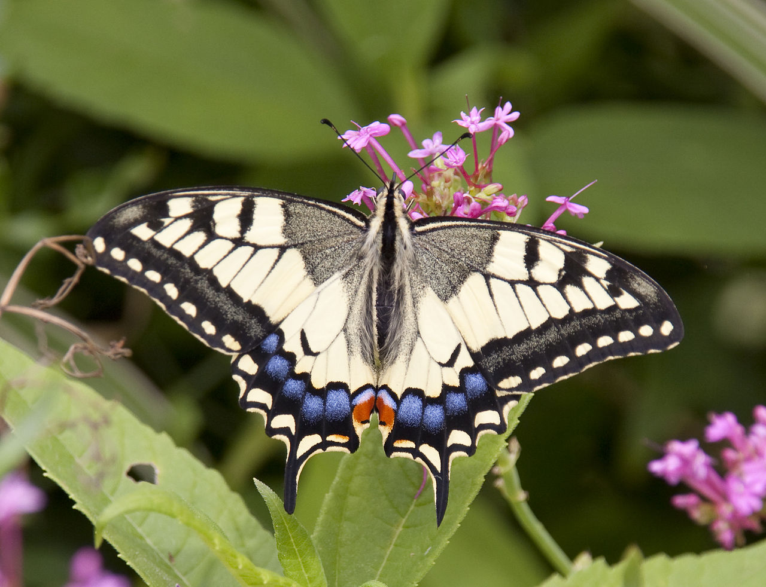
The Life Cycle Begins Again!
The butterfly will spend its time feeding from the nectar of flowers. It also drinks water and liquid from fruit.
The butterfly will look for a mate and the whole life cycle will begin again!
Photo courtesy of ahisgett (@flickr.com) - granted under creative commons licence – attribution

Slide 7
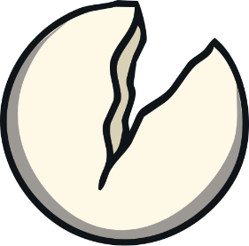
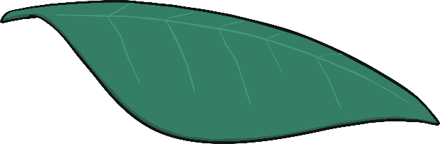
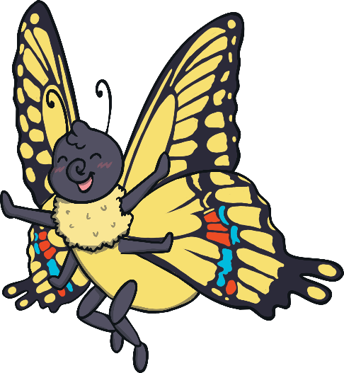
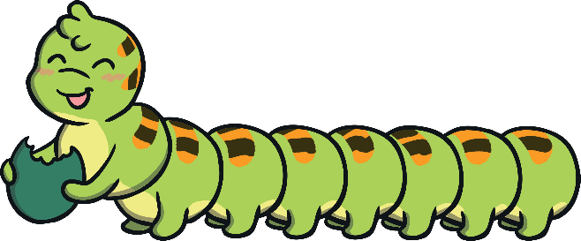
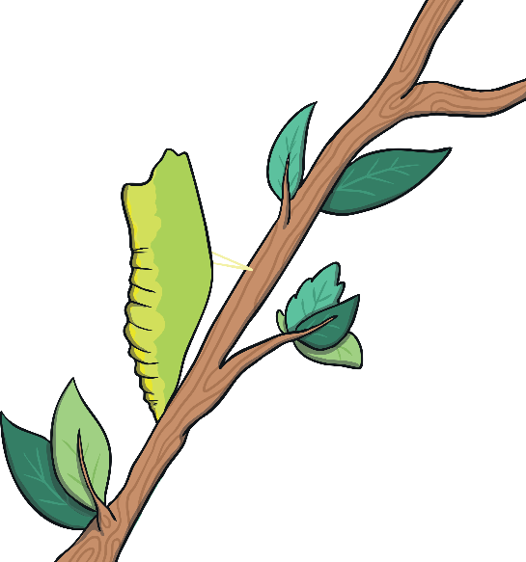
egg
butterfly
caterpillar
chrysalis

