Slide 1

Year 2 Curriculum Evening
Tuesday 8th September
Notes:
Our aims : To give you more information about the Y4 curriculum and the expectations of the children in Year 4.

Slide 2

Who’s who?

Slide 3
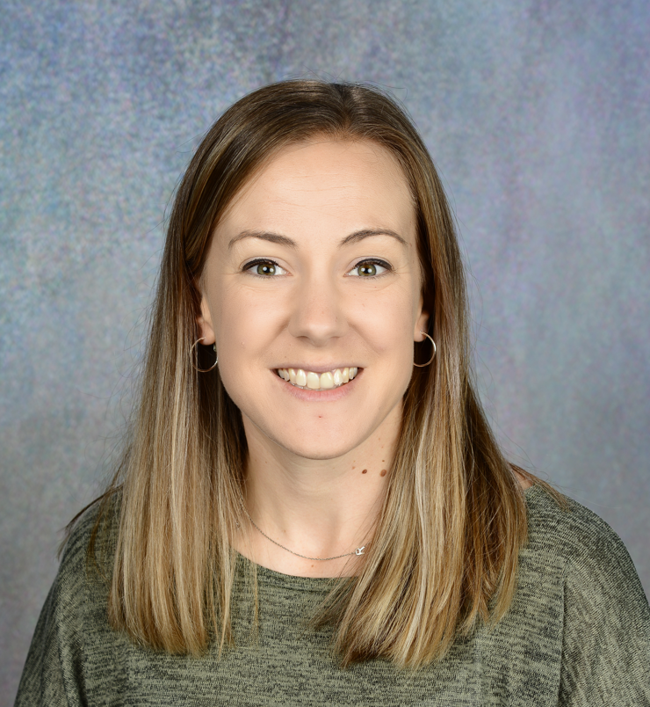
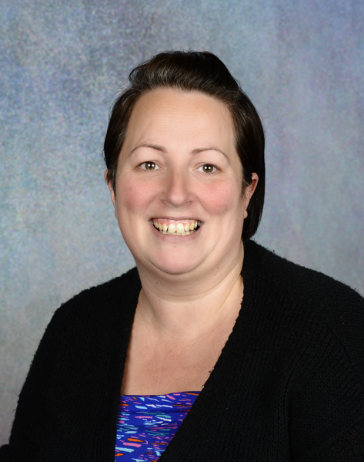
Teachers
Miss Harman
Teacher
Mrs Ford
TA all day

Slide 4
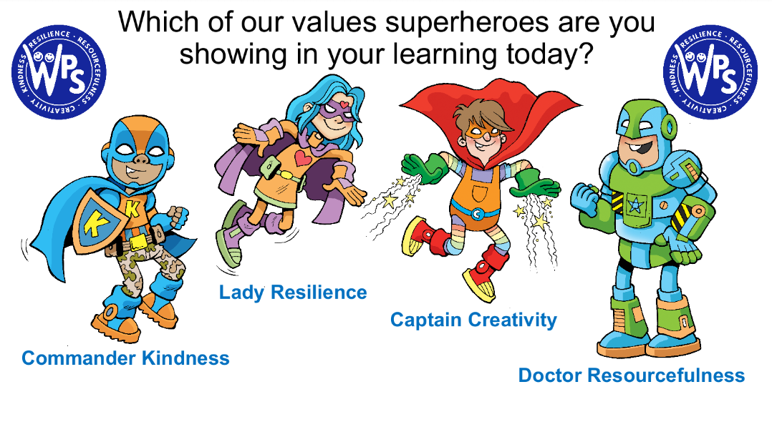
Values

Slide 5


SCHOOL RULES

Slide 6
Autumn Term
Autumn 1:
Artist Exploration: Quentin Blake
Cities in the UK
Living things and their habitats
Me and my relationships
Gymnastics
Autumn 2:
Fire pit
The Great Fire of London
Sewing
Valuing Difference
Performing and singing
Notes:
Is underpinned by aims, values of ‘a Fair Oak Learner’ and purpose for learning
Develops the whole person – knowledge, skills, understanding and attitudes
Is broad, balance and has clear progression in subject knowledge and skills
Is filled with rich first-hand purposeful experiences
Is flexible and responsive to individual needs and interests
Has an eye on the future and the needs of future citizens
Encourages the use of environments and expertise beyond the classroom
Makes meaningful links between areas of knowledge across the curriculum and the major issues of our time
Has a local, national and international dimension
Develops high expectations in the children – positive presentation
Topic based – with immersive learning opportunities where possible

Slide 7
Spring
Term
Spring 1:
Everyday materials
Transport
Making structures
Keeping Safe
Dodgeball
Robot algorithms
Spring 2:
Infant Voices festival
Life cycles
Tennis
Claude Monet
Palm Sunday
Notes:
Is underpinned by aims, values of ‘a Fair Oak Learner’ and purpose for learning
Develops the whole person – knowledge, skills, understanding and attitudes
Is broad, balance and has clear progression in subject knowledge and skills
Is filled with rich first-hand purposeful experiences
Is flexible and responsive to individual needs and interests
Has an eye on the future and the needs of future citizens
Encourages the use of environments and expertise beyond the classroom
Makes meaningful links between areas of knowledge across the curriculum and the major issues of our time
Has a local, national and international dimension
Develops high expectations in the children – positive presentation
Topic based – with immersive learning opportunities where possible

Slide 8
Summer
Term
Summer 1:
Grace Darling
Water Safety talk
Animals including Humans
Being our best
Healthy wraps
Digital music
Summer 2:
Marwell Zoo
Clay
Growing and Changing
Computer Science
Athletics
Notes:
Is underpinned by aims, values of ‘a Fair Oak Learner’ and purpose for learning
Develops the whole person – knowledge, skills, understanding and attitudes
Is broad, balance and has clear progression in subject knowledge and skills
Is filled with rich first-hand purposeful experiences
Is flexible and responsive to individual needs and interests
Has an eye on the future and the needs of future citizens
Encourages the use of environments and expertise beyond the classroom
Makes meaningful links between areas of knowledge across the curriculum and the major issues of our time
Has a local, national and international dimension
Develops high expectations in the children – positive presentation
Topic based – with immersive learning opportunities where possible

Slide 9
Assessments
Formal assessments each term
Weekly spellings
Weekly timestables (After Christmas)
SATs- informal

Slide 10
Statutory Assessment Tests (Sats)
In 2024, Key Stage 1 SATs are no longer compulsory national tests.
However, KS1 SATs have been 'replaced' by optional KS1 SATs tests. These optional SATs tests will continue to be authored, published, printed and distributed by the STA. It is likely (following STA recommendation) that all schools across England will continue to administer these tests in the same fashion as past KS1 SATs tests.
Do bear in mind that schools will choose whether they will administer these optional KS1 SATs, not individual parents.
KS1 SATs will be taken in Maths, Reading and Grammar, Punctuation and Spelling (optionally) under informal exam conditions. These papers will be marked by their teachers, along with their teacher assessments in Writing and Science.
KS1 SATs Exam Dates
The 2024 KS1 SATs will take place at some point throughout May 2025. The precise days of the tests varies from school to school as they are offered the flexibility of fitting in the tests when its deemed most convenient.

Slide 11
Rewards
Gold Award:
This is a weekly certificate given to the children who have shown the values within the week. Children will be chosen by the class teacher and parents will be invited into school on the following Monday to see their success shared with the school.
Silver Award:
Children are sent to the ‘Silver Book’ for a variety of reasons. This can be given to any children who have either shown the values or taken pride in their work.
Bronze Award:
House points make up our Bronze Award level. Children can be given house points again for a variety of reasons and it can be awarded to them by any member of staff.
Each point is awarded to their house and the house with the most points at the end of the half-term will receive a treat!

Slide 12
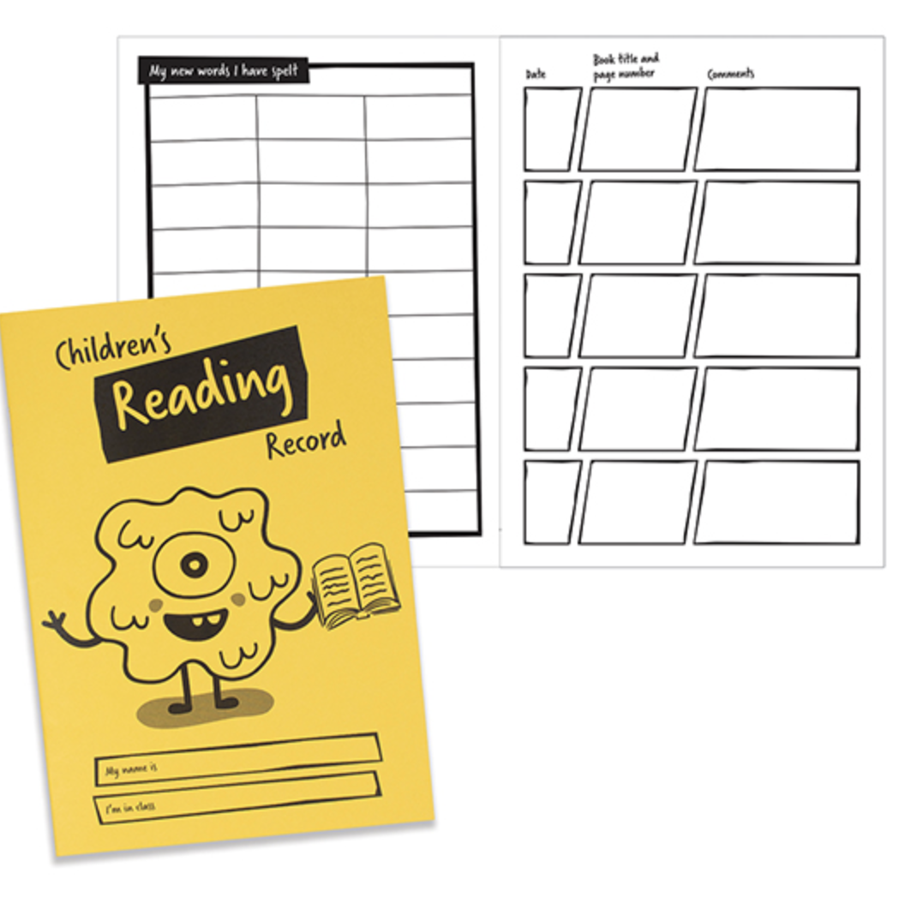
KS1 Reading diary
To read 5 times a week – parents to sign every time they read.
Can be used as a communication tool if there are any worries.
Children are awarded stars for reaching 50, 100, 200 etc.

Slide 13
Homework:
Task Set | Day Set | Day to be handed in
Daily Reading- The expectation is that the children read for at least 15 minutes a night at least five times a week. | Everyday | Everyday
Homework- Handwriting/spelling focus and Maths questions to practise and consolidate the learning that week. | Friday | The following Thursday

Slide 14

So, what will children ‘get’ at the end of the year and how do you measure progress?
Children’s learning will be measured in the following stages..
WTS, working towards standard
EXS, expected standard
GDS, greater depth standard
By the end of the year, we are aiming for as many children to ‘get to’ Expected standard or above.

Slide 15
Key Performance indicators (KPI)
A child working at the expected level of a Year 2:
By the end of Y2 a child should be mentally fluent with whole numbers, counting and place value.
A child should know the number bonds to 20 and be precise in using and understanding place value
Using practical resources, a child can work with numerals, words and the four operations (e.g. concrete objects and measuring tools)
A child can read and spell mathematical vocabulary at a level consistent with their increasing word reading and spelling knowledge at key stage 1
decode most new words outside the spoken vocabulary, making a good approximation to the word’s pronunciation
listen to and discuss a wide range of stories, poems, plays and information books, including whole books;
exercise choice in selecting books; monitor what they read, checking that the word they have decoded fits in with whatever else they have read and makes sense in the context of what they already know about the topic;

Slide 16
Key Performance indicators (KPI)
A child working at the expected level of a Year 2:
spelling, including homophones, and is able to do this for both single-syllable and multi-syllabic words;
spell words in a phonically plausible way, even if sometimes incorrectly;
explain how different types of writing, including narratives are structured and apply this to their own and others’ writing
think aloud as they collect ideas, draft and re-read to check their meaning is clear
play roles and improvise scenes in various settings
Form capital letters and digits of the correct size, orientation and relationship to one another and to lower case letters.
Use spacing between words that reflects the size of the letters.
Write simple coherent narratives about personal experiences and those of others (real or fictional)
Use present and past tense correctly and consistently
Demarcate most sentences in their writing with capital letters and full stops, and use question marks when required

Slide 17
Break and Lunchtimes
FRUIT SNACKS
CHILDREN ARE PROVIDED WITH A HEALTHY SNACK TO EAT AT BREAKTIME EG BANANAS, CARROT, TOMATOES.
RUBBISH AND LITTER
WE ASK THAT YOU REMIND THE CHILDREN TO LOOK AFTER THEIR SURROUNDINGS. THIS IS WHY THEY SHOULD EITHER USE THE BINS ON SITE OR PLACE THEIR RUBBISH BACK IN THEIR LUNCHBOXES.

Slide 18
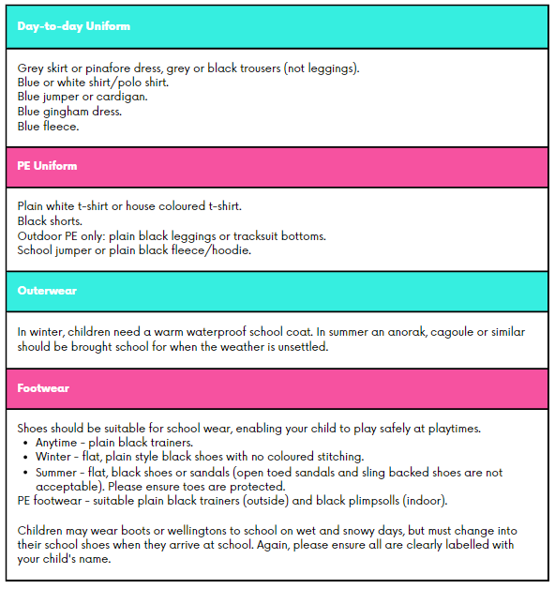
Uniform
Please name everything!

Slide 19
Uniform continued…
Shoulder length and long hair should, for safety and hygiene reasons, be tied back from the face. Hair accessories should be plain in style and in school colours.
Nail varnish, temporary tattoos etc. should not be worn to school. Patterns should not be shaved into hair.
In general, no jewellery should be worn to school. If children have pierced ears, only plain gold or silver studs should be worn. Studs must be removed or covered with tape during all PE lessons; children are expected to remove their own earrings and will be responsible for them, it is preferable not to wear earrings on PE days. Please supply your child with this earring tape in preparation for this.
A small watch may be worn, if your child can tell the time. Smart watches are not allowed to be worn and will be placed in a named envelope and handed to the parent.
If jewellery needs to be worn for religious or medical reasons, you must discuss this with the headteacher.
Sunglasses are not permitted at school unless they are prescription sunglasses. If your child wears sunglasses on the way to school, please take them home with you.
During summer weather, please provide a sun hat with a brim or peak and apply a long lasting sun protection.

Slide 20

Attendance
If your child has 90% attendance this is equivalent of:
one half a day lost every week.
four whole weeks lost in the school year.
half a school year lost over five years.
If your child is 5 minutes late every day, this is the equivalent of:
3 whole days lost in the school year.

Slide 21
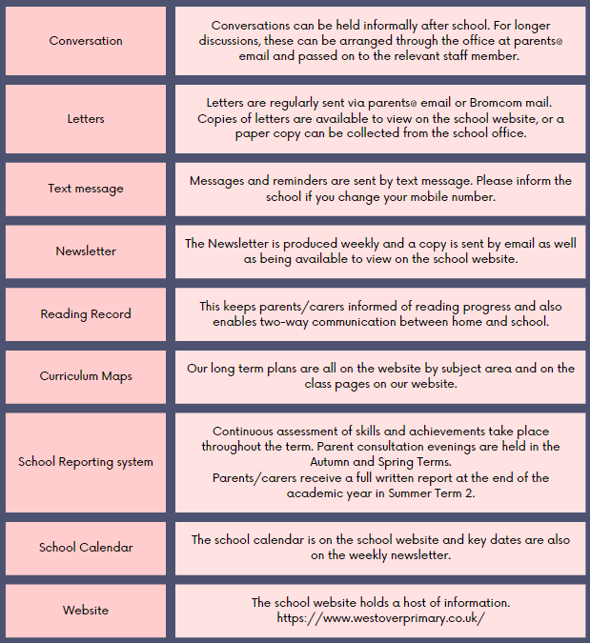
Communication
Please join our school’s Facebook page and look out for photos and news.
Class blog!!!
Updated every week.

Slide 22

How can you help at home?
Make time to read as frequently as you can!
Support your child in completing their homework
Aid your child to be ready for the day ahead with PE kit and library books given to them
Learn Times Tables
Ensure Statutory words and other spellings are learnt for the weekly test

Slide 23

How can we help?
Nobody knows your children better than you do and as a parent, your perception of our students is a valuable resource. The more we know and understand about your child, the more effective we can be as teachers so please feel free to chat with us if needed at any time. As you know, we strongly believe that a positive partnership between home and school ensures good progress and success as it is vitally important that they have a positive start to the new year so that they can grow and flourish as individuals.

Slide 24
Exit points
These take place at the end of every half term.
It is a lovely opportunity for children to showcase their learning.
Each will focus on a different subject.

Slide 25

Questions?

